Slide 1
Faculty Promotions Information Meeting
2018-2019
Dr. Sarah Mallonee, Chair
Dr. Teena-Louise White
Dr. Paul Horton

Slide 2
INDIAN RIVER STATE COLLEGE FACULTY HANDBOOK and the…
Where should I start? – 2 Resources
AGREEMENT BETWEEN THE INDIAN RIVER STATE COLLEGE DISTRICT BOARD OF TRUSTEES AND THE INDIAN RIVER STATE COLLEGE CHAPTER OF THE AMERICAN ASSOCIATION OF UNIVERSITY PROFESSORS
(AKA: the Contract)

Slide 3
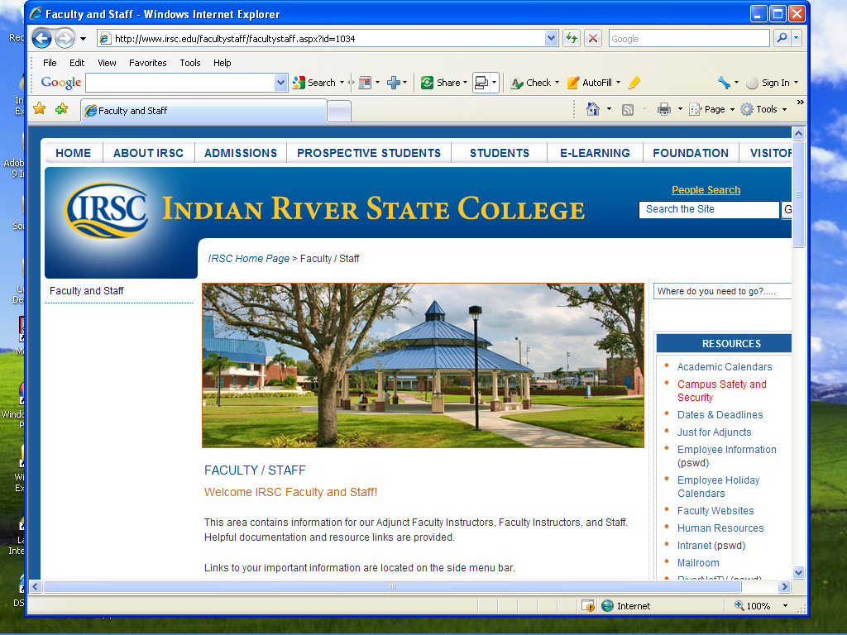
Go to the INTRANET

Slide 4
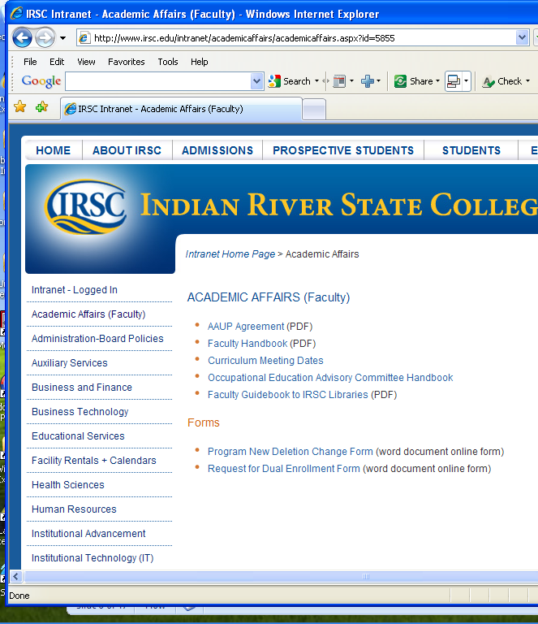
Academic Affairs (Faculty)
AAUP Agreement (PDF)
Faculty Handbook (PDF)

Slide 5
Procedure for Applying
Be sure that you are eligible for promotion
Review the current IRSC Board of Trustees / AAUP Agreement
You must meet the minimum requirements to be considered for promotion
Be sure to read and follow the application instructions as outlined in the current Faculty Handbook!

Slide 6
Ranking of Elements
In order to be recommended for promotion, candidates must present evidence of superior achievement in all four areas.
However, the four areas are not weighted equally in the Promotions Committee’s evaluation.
The single most important element in the evaluation of a candidate’s suitability for promotion is Teaching Effectiveness (or Job Effectiveness for non-teaching faculty);
Professional Development ranks second in importance,
Service to College ranks third, and
Service to Community ranks fourth.

Slide 7
Application Procedures
Letter of Intent to the Promotion Committee Chair
Email letter as an attachment
Copy (via email) to the Vice President in your discipline, the Vice President of Enrollment and Student Services, the Vice President of Academic Affairs, and to Assistant Dean of Human Resources.
It is your responsibility to maintain evidence that the electronic letter was sent.
The letter should be brief & to the point.
Specify faculty rank you currently hold and the faculty rank to which you are applying.
DO NOT send hard copies.
Include an electronic copy of the letter in Section I (Introductory Information) of your Promotions Package Files.
Deadline for submitting this letter: December 1, 2018.

Slide 8
Promotion Package Files Sub-Sections
File 1 – Introductory Information
File 2 –Teaching or Job Effectiveness
File 3 - Professional Development
File 4 - Service to the College
File 5 - Service to Community
Each section should:
begin with a summary sheet of what the section contains
followed by supporting documents or artifacts for that section (e.g., emails, letters, certifications, pictures, etc.)

Slide 9
Promotion Package Files
Introductory Information Section File should include:
Introductory Information Summary page
Letter of Intent
Statement of Eligibility
This describes your qualifications for promotion
Address the specifics that confirm that you have met the AAUP contract guidelines in regard to academic preparation and years of service.
Three Letters of Recommendation from professional colleagues
Transcripts (“Upon receipt of the promotion applicant’s letter of intent, Human Resources will email the applicant all current official transcripts on file.”)
Résumé

Slide 10
Statement of Eligibility - sample
September 1, 2018
To the AAUP Promotions Committee:
This is to confirm that I have met the minimum eligibility criteria for consideration for promotion from Assistant Professor to Associate Professor as specified in the current Indian River State College Board of Trustees/AAUP Agreement, article XV, section 2. My eligibility criteria includes the following:
I have earned continuing contract (tenure).
I have completed a minimum of three years’ full-time service in my current rank as Assistant Professor (spring 2014 to fall 2018).
I have earned a Ph.D. in History from Florida State University (which is an accredited institution).
Please let me know if you require clarification on any of the criteria listed above.
Sincerely,
Dan Mullen, Ph.D.
Assistant Professor of History
Indian River State College

Slide 11
Promotion Package Files
Submit as PDF files on a flash drive to Melissa Whigham in Human Resources.
DEADLINE: December 10th @ 5pm

Slide 12
Supporting Materials
Supporting materials for first-time applicants must be reflective of years of service.
Supporting materials for subsequent promotions must be from the last three years or since previous promotion. Do not include items that were prior to this promotion period.
Student evaluations: provide the summary of your student evaluations for each semester for the promotion period (that are available).

Slide 13
Goal of Promotion Packet
Put your best foot forward!
Let the committee know how you provide “superior achievement” above your normal duties to maintain full-time employment at IRSC
This may include what you’ve done since you were hired at IRSC to show consistent progress and professional growth, but you only need to include supporting materials since your last promotion.

Slide 14
Interview with the Promotions Committee
Interviews will be scheduled in mid-January
Opportunity for applicant to provide explanations of packet content
Clarify and respond to committee questions

Slide 15
Sample Interview Topics
Provide specifics on how you are qualified for position you are applying for
Explain the contributions you have made in support of IRSC
Discuss recent/on-going community activities you are involved in
Explain how this promotion will affect your role at IRSC
Share your future goals at the College

Slide 16
The Small Print
“Promotion is an honor … it is not a right …”
Promotions Committee recommends, but the President decides.
Seating is limited for: “The maximum number of professors and associate professors shall never exceed 38% of the total number of authorized full-time faculty positions.”
“… may apply for only one level above … except for Instructors applying for promotion to Assistant Professor upon granting of a continuing contract.”

Slide 17
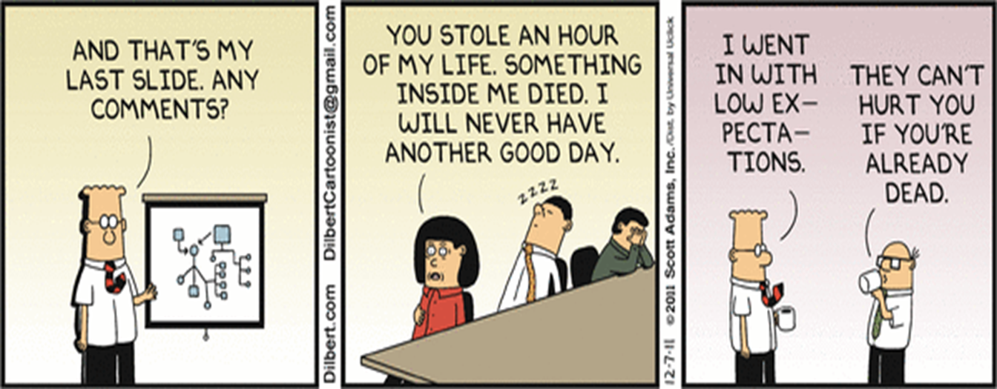
Questions??
Slides available at
https://irsc-aaup.weebly.com/

